Slide 1
INTRODUCTION TO INFORMATION SECURITY

Slide 2
OUTCOMES
Study the basics of information security
knowledge about security threats and attacks
Discuss the security issues network layer and transport layer
Apply security principles in the application layer

Slide 3
What is Security ?
“The quality or state of being secure—to be free from danger”
A successful organization should have multiple layers of security in place:
Physical security
Personal security
Operations security
Communications security
Network security
Information security

Slide 4
What is Information Security
The protection of information and its critical elements, including systems and hardware that use, store, and transmit that information
Necessary tools: policy, awareness, training, education, technology
C.I.A. triangle was standard based on confidentiality, integrity, and availability
C.I.A. triangle now expanded into list of critical characteristics of information

Slide 5
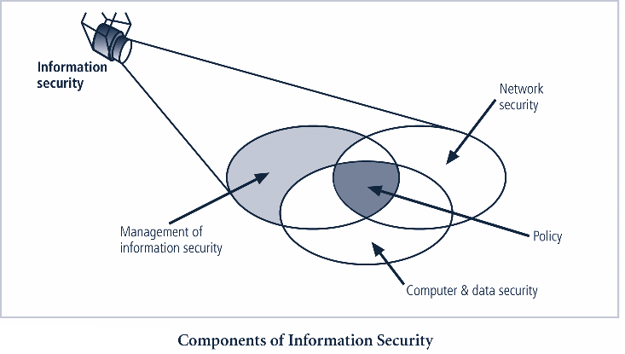

Slide 6
Critical Characteristics of Information
The value of information comes from the characteristics it possesses:
Availability
Accuracy
Authenticity
Confidentiality
Integrity
Utility
Possession

Slide 7
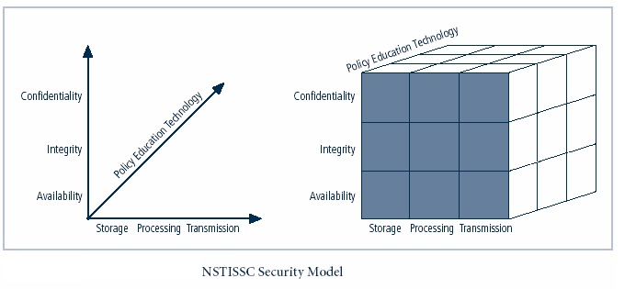

Slide 8
What is Cyber Crime
When is a crime a computer crime?
The problem of criteria.
Are all crimes involving the use or presence of a computer necessarily computer crimes?
Gotterbarn asks is a murder committed with a surgeon’s scalpel is an issue for medical ethics or just an ordinary crime.
If Gotterbarn is correct, we can ask whether having a separate category of cybercrime is necessary or even useful.
Some crimes have involved technologies other than computers, but we do not have separate categories of crime for them?
For example, people steal televisions; but we don't have a category of television crime.
People also steal automobiles but we don't have a category of automobile crime.

Slide 9
What is Cyber Crime
We can define a (genuine) cybercrime as a crime in which:
the criminal act can be carried out only through the use of cyber-technology and can take place only in the cyber realm. (Tavani, 2000)
Like Forester and Morrison's definition, this one rules out the three scenarios involving the computer lab as genuine cybercrimes.
It also rules out the income tax scenario

Slide 10
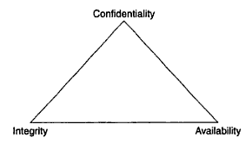
Three Pillars of Security

Slide 11
Confidentiality
The term confidentiality is used in information security to indicate whether someone has unauthorised access to information.
Someone watching you type in your pincode at an ATM, is compromising the confidentiality of that pincode.
If you leave your PC while you are still logged on, and someone starts browsing through your files in your absence, that would be an attack on the confidentiality of your information.
If that person changes a file, that would be an attack on integrity and deleting that file would be an attack on availability.

Slide 12
Integrity
The term integrity is used in Information security to indicate whether information has been changed or whether that information has errors in it.
So, someone who changes the data in a file without proper authorisation will have compromised the integrity of that data.
Attacks on integrity and availability are sometimes difficult to separate as they may have similar effects:
E.g.: Is deleting half a database of customer contacts an attack on integrity or on availability? How about deleting the address of one customer? In general, however, malicious attacks on integrity can be much more dangerous than malicious attacks on availability, as they are often not detected that easily.

Slide 13
Availability
The term availability is used in Information security to indicate whether a user has access to any information, or the system that contains/processes that information, when the user needs this access.
An attack on availability can involve deleting information or crashing a system, but it may also prevent access to the system by cutting or overloading the communication channel to that system.
The most common attacks on availability are, however, simple things like hardware failure or power failure

Slide 14
An Introduction to HTTP
Hyper Text Transfer Protocol
One of the application layer protocols that make up the Internet
HTTP over TCP/IP
Like SMTP, POP, IMAP, NNTP, FTP, etc.
The underlying language of the Web
Three versions have been used, two are in common use and have been specified:
RFC 1945 HTTP 1.0 (1996)
RFC 2616 HTTP 1.1 (1999)

Slide 15
HTTPS
=
HTTP + SSL

Slide 16
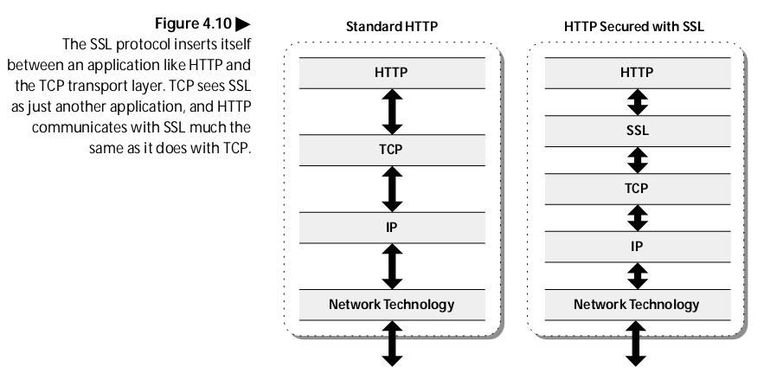
HTTPS

Slide 17
What is a Firewall?
A choke point of control and monitoring
Interconnects networks with differing trust
Imposes restrictions on network services
only authorized traffic is allowed
Auditing and controlling access
can implement alarms for abnormal behavior
Itself immune to penetration
Provides perimeter defence

Slide 18
Classification of Firewall
Characterized by protocol level it controls in
Packet filtering
Circuit gateways
Application gateways
Combination of above is dynamic packet filter

Slide 19
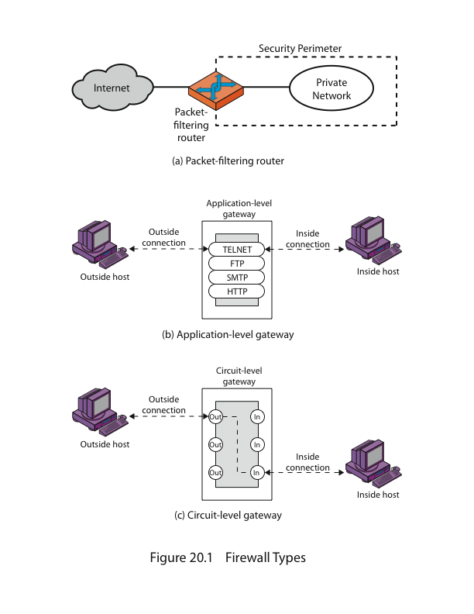
Firewalls – Packet Filters

Slide 20
Firewalls – Packet Filters
Simplest of components
Uses transport-layer information only
IP Source Address, Destination Address
Protocol/Next Header (TCP, UDP, ICMP, etc)
TCP or UDP source & destination ports
TCP Flags (SYN, ACK, FIN, RST, PSH, etc)
ICMP message type
Examples
DNS uses port 53
No incoming port 53 packets except known trusted servers

Slide 21
Firewall Gateways
Firewall runs set of proxy programs
Proxies filter incoming, outgoing packets
All incoming traffic directed to firewall
All outgoing traffic appears to come from firewall
Policy embedded in proxy programs
Two kinds of proxies
Application-level gateways/proxies
Tailored to http, ftp, smtp, etc.
Circuit-level gateways/proxies
Working on TCP level

Slide 22
Firewalls - Application Level Gateway (or Proxy)

Slide 23
Firewalls - Circuit Level Gateway

Slide 24
Operating System Fingerprinting
Remotely detect the Operating System type and version of a remote host.
The majority of OS fingerprinting tools detect remote hosts’ OS information by analyzing TCP/IP traffic regarding to the target hosts.
The traffic may be generated by the fingerprinting tools.
The traffic may just be the normal traffic going through the target hosts.

Slide 25
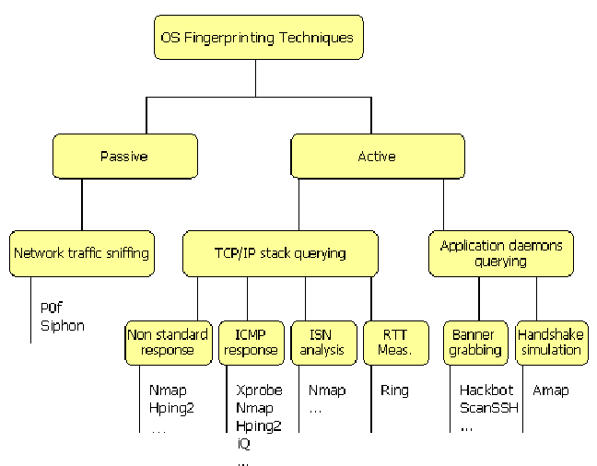
OS Fingerprinting Techniques And Corresponding Tools

Slide 26
References
Atul Kahate, “Cryptography and Network Security”, Second Edition, McGrawHill, 2010.
Information System Security, Nina Godbole, Wiley India, First Edition 2009.
Fundamentals of Information System Security, David Kim, Second Edition 2013.

